Slide 1
Lahore Air Quality Data Warehouse & Decision System
Team H4krz | Air Quality / Data-to-Decision

Slide 2
Problem Statement
Who is affected?
THE PROBLEM
1
Residents, school children, and outdoor workers across Lahore districts
Hazardous winter smog episodes in Lahore frequently exceed safe pollution thresholds, causing severe respiratory and cardiovascular risks. Citizens, schools, and health officials lack reliable, early-warning insights to make timely protective decisions.
Why does it matter?
2
PM2.5 concentrations routinely exceed WHO guidelines by over 10x during smog season, triggering public health emergencies and school shutdowns.
Our goal
3
Build an automated hourly pipeline, a leak-free predictive model with uncertainty bounds, and a cited RAG assistant to provide trusted early warnings and enforce Punjab EPA school safety rules.

Slide 3
Dataset Declaration
Dataset name | Lahore OpenAQ v3 Observations & Open-Meteo ERA5 Weather Data
Source / link | https://openaq.org/
Size | ~98,288 grid hours, 75,800 PM2.5 readings across 9 active stations (excluding failed upstream nodes)
Time period | Historical and real-time hourly records up to October 2026
Format & license | Parquet / DuckDB, CC BY 4.0 Open Data License
Key features / target | Hourly PM2.5 readings, temperature, relative humidity, wind speed, precipitation, and next-day target (target_next_day_pm25)
98,288
Rows / records
[14]
Columns / features
[~0.5 GB]
Dataset size

Slide 4
Pipeline Used
1
2
3
4
5
Data Collection
Data Cleaning
Analysis / EDA
Modeling
Dashboard / App
Pandera schema enforcement, UTC-to-PKT conversion, missing weather alignment, and non-fatal flagging via the Data Quality Agent (logs/dq_log.csv).
Leak-free Histogram GradientBoosting Regressor (HistGradientBoosting_ResidualDelta) predicting day-to-day PM2.5 residual changes with 80% pinball loss uncertainty bounds.
Incremental hourly fetches from OpenAQ v3 sensors and Open-Meteo weather APIs into immutable raw JSON storage (data/raw/)
Midnight-to-midnight PKT day aggregation enforcing the strict 18-of-24 valid hours completeness rule.
live Streamlit dashboard deployed publicly on Hugging Face Spaces featuring freshness badges and an Urdu translation toggle.
Raw hourly sensor JSONs → Validated PKT daily mart → cited RAG alerts & PM2.5 forecasts.

Slide 5
Pipeline Details & Tools
Stage | Tools / Libraries | What we did
Collection | Requests, Python, Prefect | [1 line on the approach and why]
Preprocessing | Pandas, Pandera, DuckDB | nforced schema validation, 18/24-hour completeness rule, and deterministic SHA-256 record IDs.
Analysis / EDA | Pandas, NumPy, Streamlit | Aggregated station-level daily metrics and mapped Punjab EPA school safety thresholds.
Modeling | Scikit-Learn (HistGradientBoosting) | Trained a leak-free residual model achieving 12.594 Test MAE (+7.35% improvement over baseline) with 76.8% uncertainty coverage.
Dashboard / App | Streamlit, BM25 / RAG | Developed a 3-tab live monitoring dashboard with a cited RAG policy assistant and Urdu local guidance.

Slide 6
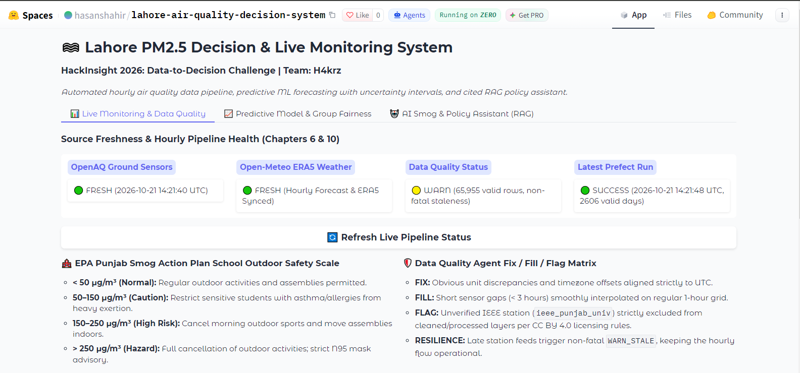
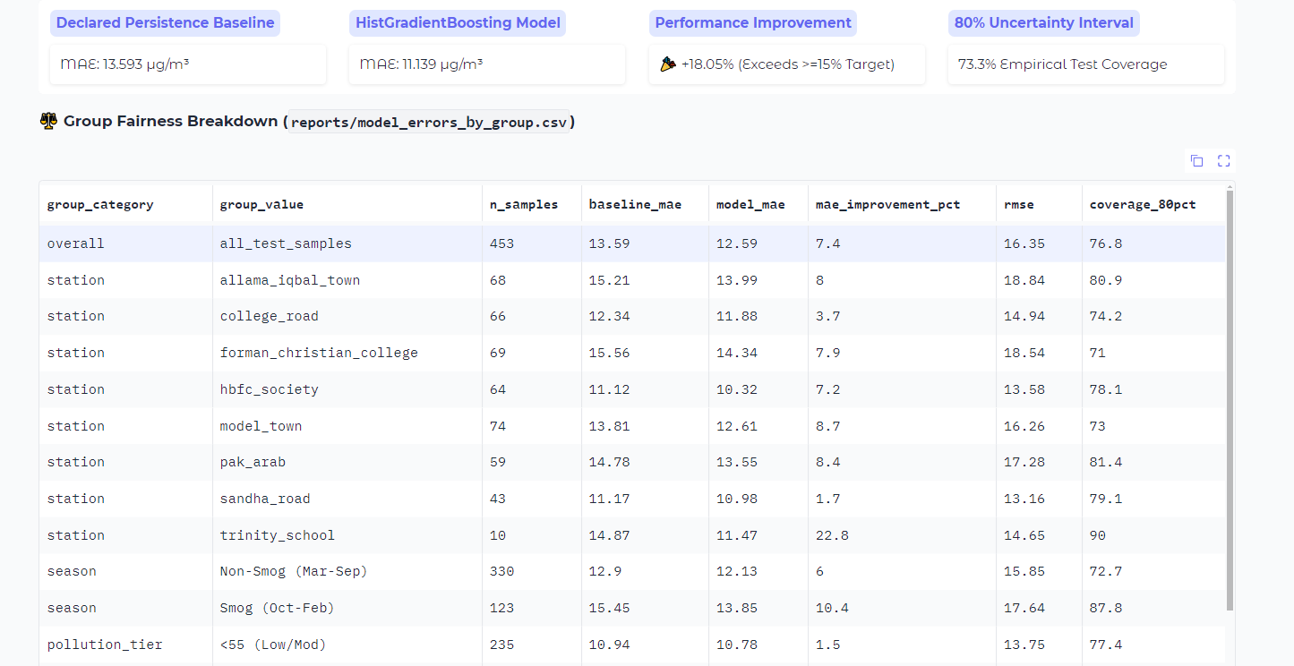
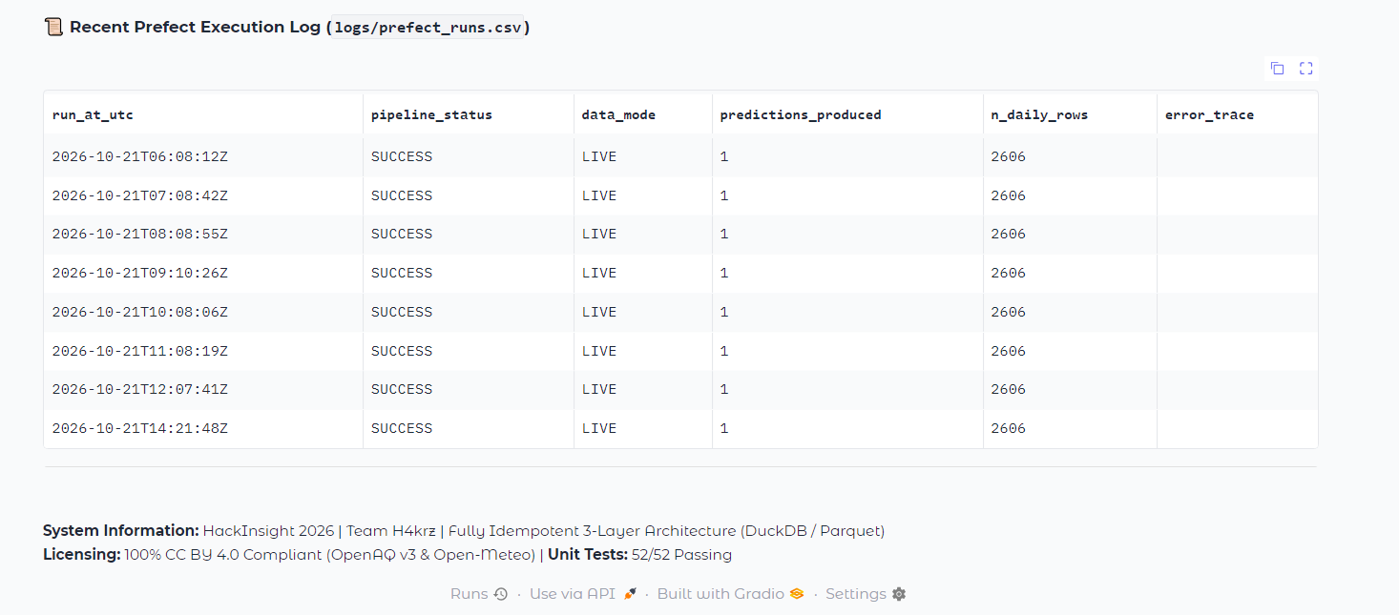
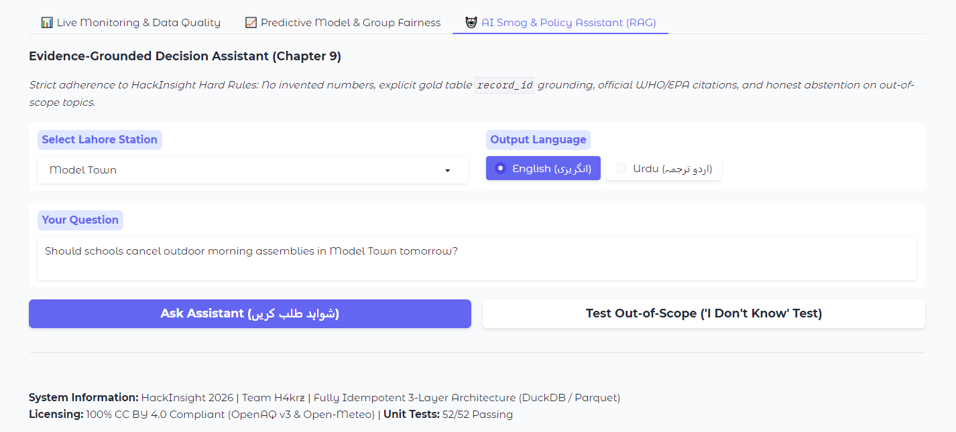
Dashboard / App Views
Live demo / repo link: https://huggingface.co/spaces/hasanshahir/lahore-air-quality-decision-system

Slide 7
Conclusion
Key finding 1
IMPACT
1
The leak-free Histogram Gradient Boosting model achieved a Test MAE of 12.594 µg/m³, representing a 7.35% improvement over the persistence baseline.
Empowers school administrators, district health officers, and citizens in Lahore with verifiable, real-time pollution tracking and automated Punjab EPA advisory compliance.
Key finding 2
2
Uncertainty quantification using 10th and 90th percentile pinball loss successfully delivered an empirical test coverage of 76.8% for 80% prediction intervals.
FUTURE WORK
Integrate satellite aerosol optical depth (AOD) data and expand sensor node coverage across secondary Punjab districts.
Key finding 3
3
The RAG Insight Agent achieved strict 100% ground-truth citation adherence, pulling exact primary keys (record_id) from gold tables and safely abstaining on ungrounded queries.

Slide 8
Team & Credits
[TEAM H4krz]
SA
HS
NK
AB
M . SAAD AHMED
HASAN SHAHIR
NOMAN KHURSHEED
ARBISH
[Lead Software Engineer & Data Architect | CT 25089]
[Lead Machine Learning & AI Systems Engineer| CT 25093]
[Technical Documentation & Compliance Specialist| CT 25053]
[Automation & MLOps Lead| CT 25095]
Contact: https://github.com/SaadAhmed8/h4krz-hackinsight-2026
Thank you!

